Slide 1
Aggregate Demand
and Aggregate Supply
© 2015 Cengage Learning. All Rights Reserved. May not be copied, scanned, or duplicated, in whole or in part, except for use as permitted in a license distributed with a certain product or service or otherwise on a password-protected website for classroom use.

Slide 2
Short-Run Economic Fluctuations
Classical dichotomy
  Separation of variables into:
    Real variables
    Nominal variables
Monetary neutrality
  Changes in the money supply
    Affect nominal variables
    Do not affect real variables
© 2015 Cengage Learning. All Rights Reserved. May not be copied, scanned, or duplicated, in whole or in part, except for use as permitted in a license distributed with a certain product or service or otherwise on a password-protected website for classroom use.

Slide 3
Short-Run Economic Fluctuations
Classical theory holds in the long-run
  Changes in money supply
    Affect prices, and other nominal variables
    Do not affect real GDP, unemployment, or other real variables
© 2015 Cengage Learning. All Rights Reserved. May not be copied, scanned, or duplicated, in whole or in part, except for use as permitted in a license distributed with a certain product or service or otherwise on a password-protected website for classroom use.

Slide 4
Short-Run Economic Fluctuations
Short-run
  Assumption of monetary neutrality: no longer appropriate
  Real and nominal variables are highly intertwined
  Changes in the money supply
    Can temporarily push real GDP away from its long-run trend
© 2015 Cengage Learning. All Rights Reserved. May not be copied, scanned, or duplicated, in whole or in part, except for use as permitted in a license distributed with a certain product or service or otherwise on a password-protected website for classroom use.

Slide 5
Short-Run Economic Fluctuations
AD-AS model
  Model of aggregate demand (AD) and aggregate supply (AS)
  Most economists use it to explain short-run fluctuations in economic activity
    Around its long-run trend
© 2015 Cengage Learning. All Rights Reserved. May not be copied, scanned, or duplicated, in whole or in part, except for use as permitted in a license distributed with a certain product or service or otherwise on a password-protected website for classroom use.

Slide 6
Short-Run Economic Fluctuations
Aggregate-demand curve
  Shows the quantity of goods and services
  That households, firms, the government, and customers abroad
  Want to buy at each price level
  Downward sloping
© 2015 Cengage Learning. All Rights Reserved. May not be copied, scanned, or duplicated, in whole or in part, except for use as permitted in a license distributed with a certain product or service or otherwise on a password-protected website for classroom use.

Slide 7
Short-Run Economic Fluctuations
Aggregate-supply curve
  Shows the quantity of goods and services
  That firms choose to produce and sell
  At each price level
  Upward sloping
© 2015 Cengage Learning. All Rights Reserved. May not be copied, scanned, or duplicated, in whole or in part, except for use as permitted in a license distributed with a certain product or service or otherwise on a password-protected website for classroom use.

Slide 8
Figure 2
Aggregate Demand and Aggregate Supply
Price
Level
Aggregate supply
Equilibrium
price level
Aggregate demand
Equilibrium
output
Quantity of
Output
Economists use the model of aggregate demand and aggregate supply to analyze economic fluctuations. On the vertical axis is the overall level of prices. On the horizontal axis is the economy’s total output of goods and services. Output and the price level adjust to the point at which the aggregate-supply and aggregate-demand curves intersect.

Slide 9
The Aggregate-Demand Curve
Y = C + I + G + NX
Three effects explain why AD curve slopes downward:
  Wealth effect (C )
  Interest-rate effect (I)
  Exchange-rate effect (NX)
Assumption: government spending (G)
  Fixed by policy

Slide 10
The Aggregate-Demand Curve
Price level and consumption (C): the wealth effect
  Decrease in price level
    Increase in the real value of money
    Consumers are wealthier
    Increase in consumer spending
    Increase in quantity demanded of goods and services

Slide 11
The Aggregate-Demand Curve
Price level and investment (I): the interest-rate effect
  Decrease in price level
    Decrease in the interest rate
    Increase spending on investment goods
    Increase in quantity demanded of goods and services

Slide 12
The Aggregate-Demand Curve
Price level and net exports (NX): the exchange-rate effect
  Decrease in U.S. price level
    Decrease in the interest rate
    U.S. dollar depreciates
    Stimulates U.S. net exports
    Increase in quantity demanded of goods and services

Slide 13
The Aggregate-Demand Curve
A fall in price level
  Increases quantity of goods and services demanded
  Because:
    Consumers are wealthier: stimulates the demand for consumption goods
    Interest rates fall: stimulates the demand for investment goods
    Currency depreciates: stimulates the demand for net exports

Slide 14
The Aggregate-Demand Curve
A rise in price level
  Decreases the quantity of goods and services demanded
  Because:
    Consumers are poorer: depress consumer spending
    Higher interest rates fall: depress investment spending
    Currency appreciates: depress net exports

Slide 15
Figure 3
The Aggregate-Demand Curve
Price
Level
1. A decrease in the price level . . .
P₁
2. . . . increases the quantity of
goods and services demanded
P₂
Aggregate demand
Y₁
Y₂
Quantity of Output
A fall in the price level from P₁ to P₂ increases the quantity of goods and services demanded from Y₁ to Y₂. There are three reasons for this negative relationship. As the price level falls, real wealth rises, interest rates fall, and the exchange rate depreciates. These effects stimulate spending on consumption, investment, and net exports. Increased spending on any or all of these components of output means a larger quantity of goods and services demanded.

Slide 16
The Aggregate-Demand Curve
The AD curve might shift:
  Changes in consumption, C
  Changes in investment, I
  Changes in government purchases, G
  Changes in net exports, NX

Slide 17
The Aggregate-Demand Curve
Changes in consumption, C
  Events that change how much people want to consume at a given price level
    Changes in taxes, wealth
  Increase in consumer spending
    Aggregate-demand curve: shift right

Slide 18
The Aggregate-Demand Curve
Changes in investment, I
  Events that change how much firms want to invest at a given price level
    Better technology
    Tax policy
    Money supply
  Increase in investment
    Aggregate-demand curve: shift right

Slide 19
The Aggregate-Demand Curve
Changes in government purchases, G
  Policy makers – change government spending at a given price level
    Build new roads
  Increase in government purchases
    Aggregate-demand curve: shift right

Slide 20
The Aggregate-Demand Curve
Changes in net exports, NX
  Events that change net exports for a given price level
    Recession in trading partners’ economy
    International speculators – change in exchange rate
  Increase in net exports
    Aggregate-demand curve: shift right

Slide 21
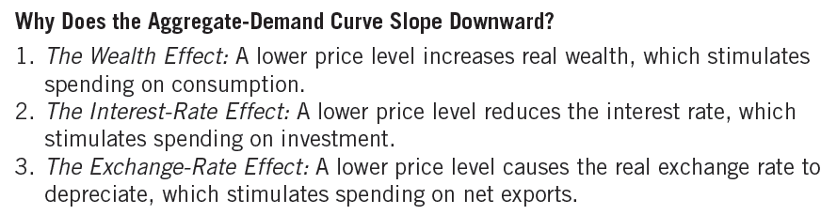
Table 1
The Aggregate-Demand Curve: Summary

Slide 22
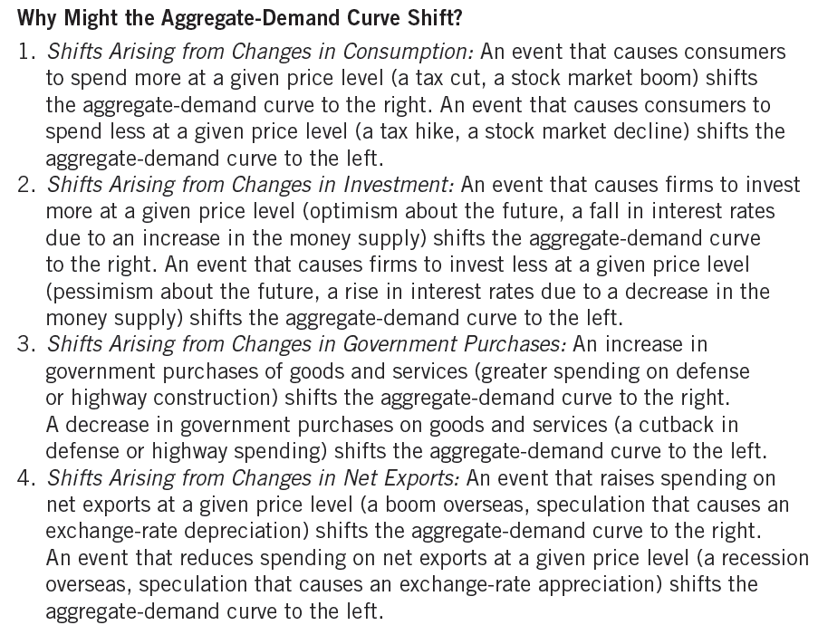
Table 1
The Aggregate-Demand Curve: Summary

Slide 23
The Aggregate-Supply Curve
Long run aggregate-supply curve, LRAS
  Aggregate-supply curve is vertical
    Price level does not affect the long-run determinants of GDP:
      Supplies of labor, capital, and natural resources
      Available technology
Short run
  Aggregate-supply curve is upward sloping

Slide 24
Figure 4
The Long-Run Aggregate-Supply Curve
Price
Level
Long-run
aggregate
supply
P₁
1. A change in the price
level . . .
P₂
2. . . . does not affect the quantity of goods and services supplied in the long run
Natural level
of output
Quantity of Output
In the long run, the quantity of output supplied depends on the economy’s quantities of labor, capital, and natural resources and on the technology for turning these inputs into output. Because the quantity supplied does not depend on the overall price level, the long-run aggregate-supply curve is vertical at the natural level of output.

Slide 25
The Aggregate-Supply Curve
Natural level of output
  Production of goods and services
  That an economy achieves in the long run
    When unemployment is at its normal rate
  Potential output
  Full-employment output

Slide 26
The Aggregate-Supply Curve
The LRAS curve might shift
  Any change in natural level of output
    Changes in labor
    Changes in capital
    Changes in natural resources
    Changes in technological knowledge

Slide 27
The Aggregate-Supply Curve
Changes in labor
  Quantity of labor – increases
    Aggregate-supply curve: shifts right
  Natural rate of unemployment – increases
    Aggregate-supply curve: shifts left
Changes in capital
  Capital stock – increase
    Aggregate-supply curve: shifts right
  Physical and human capital

Slide 28
The Aggregate-Supply Curve
Changes in natural resources
  New discovery of natural resource
    Aggregate-supply curve: shifts right
  Weather
  Availability of natural resources

Slide 29
The Aggregate-Supply Curve
Changes in technology
  New technology, for given labor, capital and natural resources
    Aggregate-supply curve: shifts right
  International trade
  Government regulation

Slide 30
Long-Run Growth and Inflation
In long run: both AD and LRAS curve shift
  Continual shifts of LRAS curve to right
    Technological progress
  AD curve shifts to right
    Monetary policy
    The Fed increases money supply over time
  Result:
    Continuing growth in output
    Continuing inflation

Slide 31
Figure 5
Long-Run Growth and Inflation in the Model of Aggregate Demand and Aggregate Supply
Price
Level
LRAS₁₉₉₀
LRAS₂₀₀₀
LRAS₂₀₁₀
2. . . . and growth in the money supply shifts aggregate demand . . .
1. In the long run, technological progress shifts long-run aggregate supply…
P₂₀₁₀
3. . . . leading to growth in output . . .
P₂₀₀₀
P₁₉₉₀
AD₂₀₁₀
4. . . . and
ongoing inflation
AD₁₉₉₀
AD₂₀₀₀
Y₁₉₉₀
Y₂₀₀₀
Y₂₀₁₀
Quantity of Output
As the economy becomes better able to produce goods and services over time, primarily because of technological progress, the long-run aggregate-supply curve shifts to the right. At the same time, as the Fed increases the money supply, the aggregate-demand curve also shifts to the right. In this figure, output grows from Y₁₉₉₀ to Y₂₀₀₀ and then to Y₂₀₁₀, and the price level rises from P₁₉₉₀ to P₂₀₀₀ and then to P₂₀₁₀. Thus, the model of aggregate demand and aggregate supply offers a new way to describe the classical analysis of growth and inflation.

Slide 32
The Aggregate-Supply Curve
In the short-run:
  Increase in overall level of prices in economy
    Tends to raise the quantity of goods and services supplied
  Decrease in level of prices
    Tends to reduce quantity of goods and services supplied

Slide 33
Figure 6
The Short-Run Aggregate-Supply Curve
Price
Level
Short-run
aggregate
supply
1. A decrease in the price level . . .
P₁
P₂
2. . . . reduces the quantity of goods and services supplied in the short run
Y₂
Y₁
Quantity of Output
In the short run, a fall in the price level from P₁ to P₂ reduces the quantity of output supplied from Y₁ to Y₂. This positive relationship could be due to sticky wages, sticky prices, or misperceptions. Over time, wages, prices, and perceptions adjust, so this positive relationship is only temporary.

Slide 34
The Aggregate-Supply Curve
Theories that explain why the AS curve slopes upward in short-run:
  Sticky-wage theory
  Sticky-price theory
  Misperceptions theory

Slide 35
The Aggregate-Supply Curve
Sticky-wage theory
  Nominal wages - slow to adjust to changing economic conditions
    Long-term contracts: workers and firms
    Slowly changing social norms
    Notions of fairness - influence wage setting
  Nominal wages - based on expected prices
    Don’t respond immediately when actual price level – different from what was expected

Slide 36
The Aggregate-Supply Curve
Sticky-wage theory
  If price level < expected
    Firms – incentive to produce less output
  If price level > expected
    Firms – incentive to produce more output

Slide 37
The Aggregate-Supply Curve
Sticky-price theory
  Prices of some goods and services
    Slow to adjust to changing economic conditions
    Menu costs
      Costs to adjusting prices

Slide 38
The Aggregate-Supply Curve
Misperceptions theory
  Changes in the overall price level
    Can temporarily mislead suppliers
      About changes in individual markets
      Changes in relative prices
    Suppliers - respond to changes in level of prices
      Change - quantity supplied of goods and services

Slide 39
The Aggregate-Supply Curve
Quantity of output supplied =
  = Natural level of output +
  + a(Actual price level – Expected price level)
    Where a - number that determines how much output responds to unexpected changes in the price level

Slide 40
The Aggregate-Supply Curve
The short-run AS curve might shift:
  Changes in labor, capital, natural resources, or technological knowledge
  Expected price level increases
    Aggregate-supply curve: shifts left

Slide 41
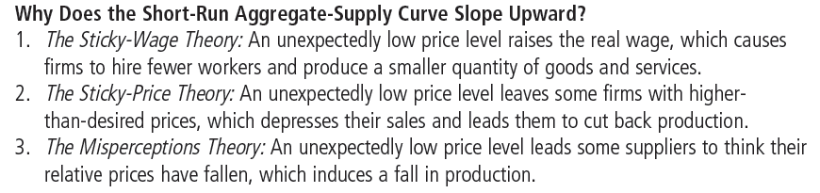
Table 2
The Short-Run Aggregate-Supply Curve: Summary

Slide 42
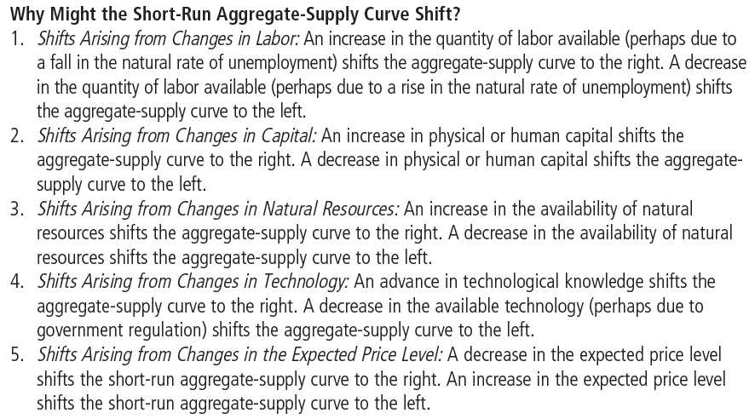
Table 2
The Short-Run Aggregate-Supply Curve: Summary

Slide 43
Causes of Economic Fluctuations
Assumption
  Economy begins in long-run equilibrium
Long-run equilibrium:
  Intersection of AD and LRAS curves
    Natural level of output
    Actual price level
  Intersection of AD and short-run AS curve
    Expected price level = Actual price level

Slide 44
Figure 7
The Long-Run Equilibrium
Price
Level
Long-run
aggregate
supply
Short-run
aggregate
supply
Equilibrium
price
A
Aggregate
demand
Natural level
of output
Quantity of Output
The long-run equilibrium of the economy is found where the aggregate-demand curve crosses the long-run aggregate-supply curve (point A). When the economy reaches this long-run equilibrium, the expected price level will have adjusted to equal the actual price level. As a result, the short-run aggregate-supply curve crosses this point as well.

Slide 45
Causes of Economic Fluctuations
Shift in aggregate demand
  Wave of pessimism: AD shifts left
  Short-run
    Output falls
    Price level falls
  Long-run
    Short-run aggregate-supply curve shifts right
    Output – natural level
    Price level – falls

Slide 46
Table 3
Four Steps for Analyzing Macroeconomic Fluctuations
1. Decide whether the event shifts the aggregate-demand curve or the aggregate-supply curve (or perhaps both).
2. Decide the direction in which the curve shifts.
3. Use the diagram of aggregate demand and aggregate supply to determine the impact on output and the price level in the short run.
4. Use the diagram of aggregate demand and aggregate supply to analyze how the economy moves from its new short-run equilibrium to its long-run equilibrium.

Slide 47
Figure 8
A Contraction in Aggregate Demand
Price
Level
Long-run aggregate supply
Short-run aggregate supply, AS₁
3. . . . but over time, the short-run aggregate-supply curve shifts . . .
AS₂
P₁
A
B
4. . . . and output returns to its natural level.
P₂
C
P₃
1. A decrease in aggregate demand . . .
AD₂
Aggregate demand, AD₁
Y₂
Y₁
Quantity of Output
2. . . . causes output to fall in the short run . . .
A fall in aggregate demand is represented with a leftward shift in the aggregate-demand curve from AD₁ to AD₂. In the short run, the economy moves from point A to point B. Output falls from Y₁ to Y₂, and the price level falls from P₁ to P₂. Over time, as the expected price level adjusts, the short-run aggregate-supply curve shifts to the right from AS₁ to AS₂, and the economy reaches point C, where the new aggregate-demand curve crosses the long-run aggregate-supply curve. In the long run, the price level falls to P₃, and output returns to its natural level, Y₁.

